Slide 1

Maze Solving Robot
Zak Oster

Slide 2


Master’s Project
Implementing a Cohesive Programming Ecosystem in Mechanical Engineering

Slide 3
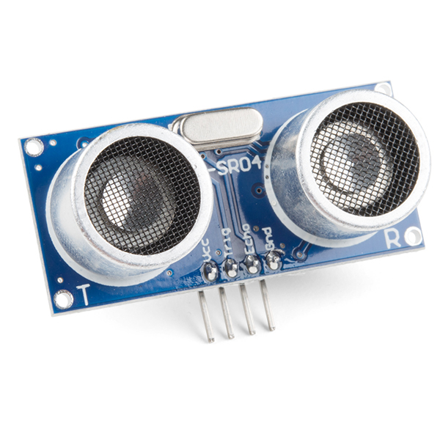
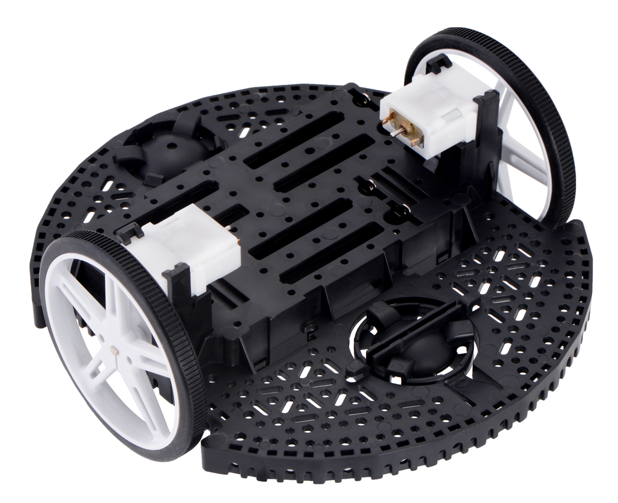
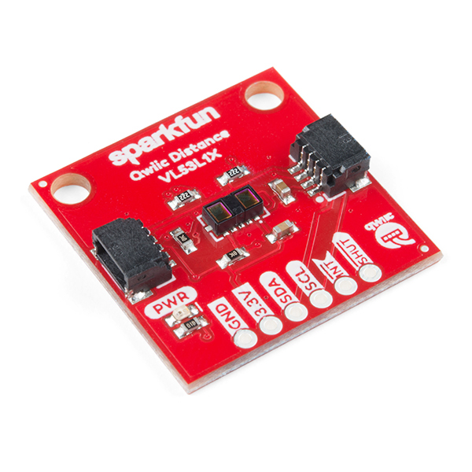
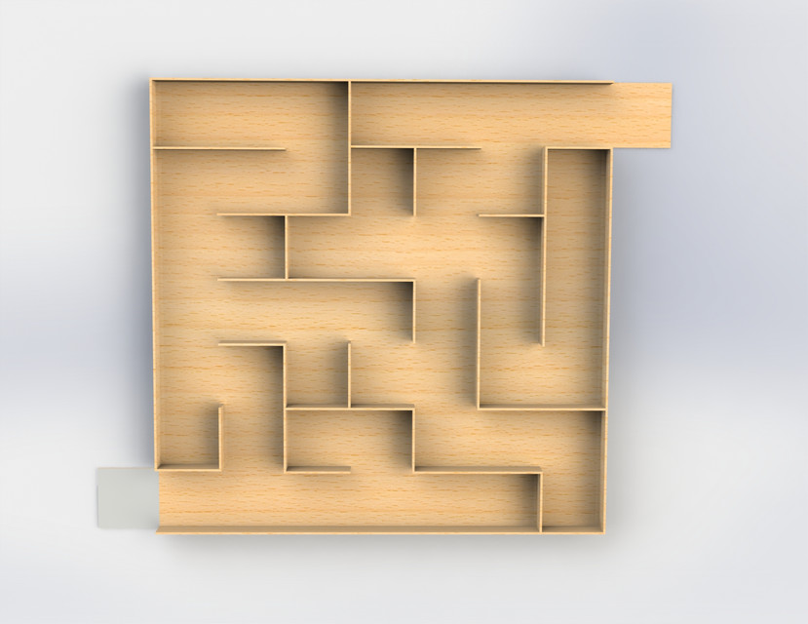
ME 615: Mechatronics Project

Slide 4
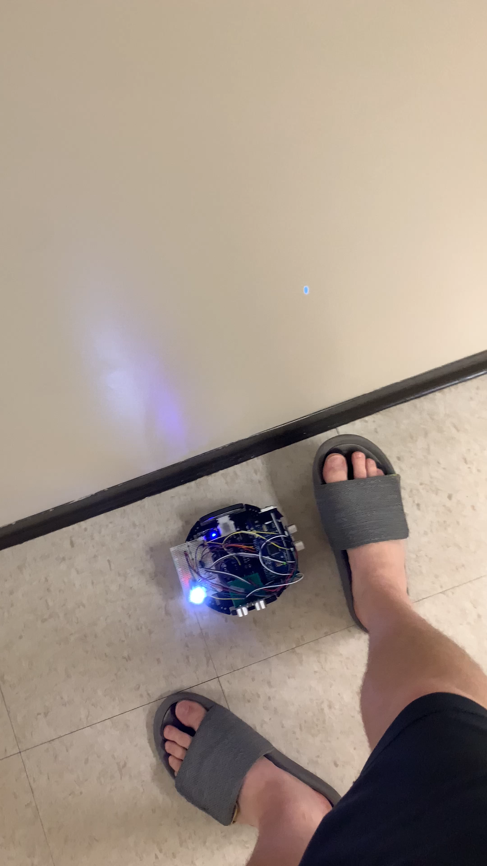

Slide 5
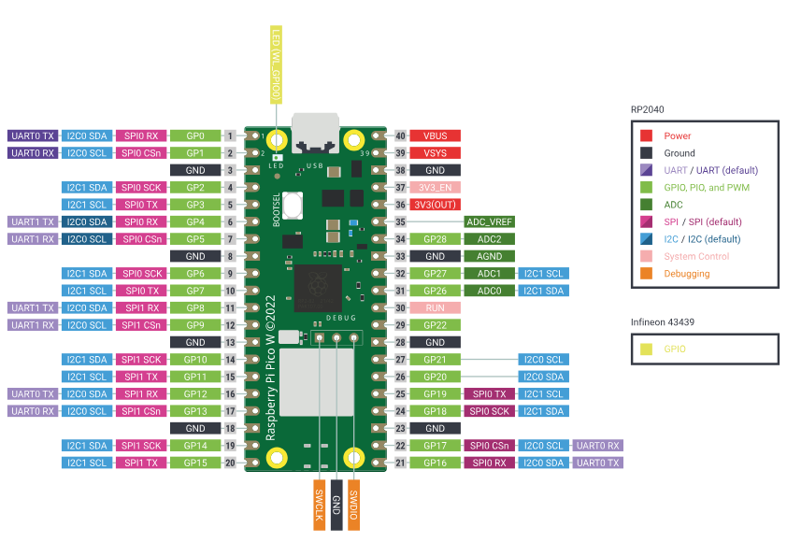
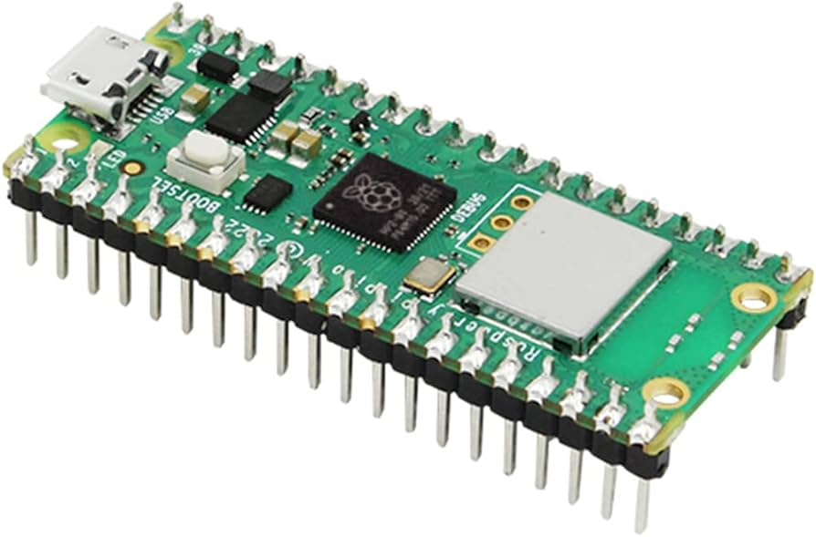
Raspberry Pi Pico W
Notes:
Dual core ARM processor
264 kB internal RAM
2MB onboard flash
2.4GHz wifi
5.2 Bluetooth
26 GPIO pins
2 I2C buses, 2 SPI, 2 UART
16 PWM channels
8 PIO

Slide 6
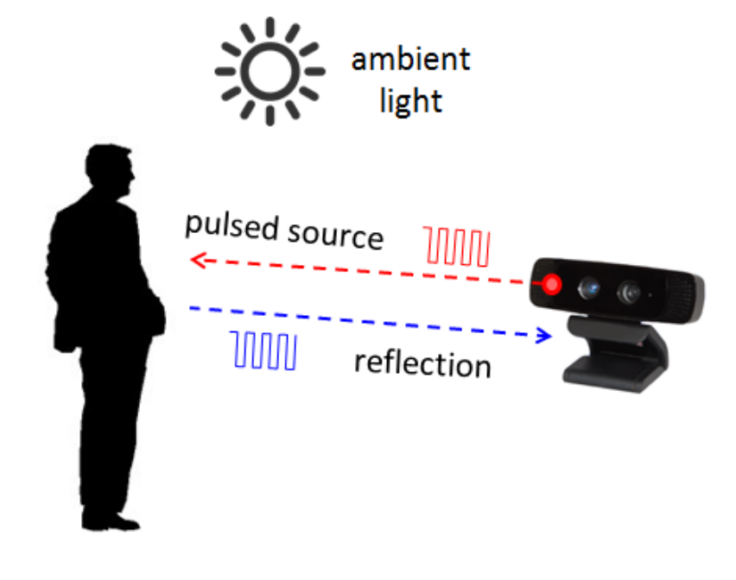
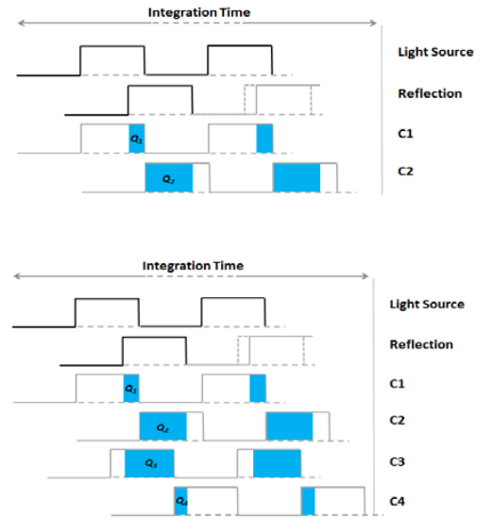
Time of Flight Sensors
Typically ~850nm
Two primary methods
Pulsed source
Continuous wave
Very useful for depth
Notes:
https://www.ti.com/lit/wp/sloa190b/sloa190b.pdf?ts=1696803870049&ref_url=https%253A%252F%252Fwww.google.com%252F#:~:text=Theory%20of%20Operation,illustrates%20the%20basic%20TOF%20concept.

Slide 7
Sparkfun Distance Sensor (VL53L1X)
I2C Optical Sensor
40mm – 4m range
940nm wavelength

Slide 8
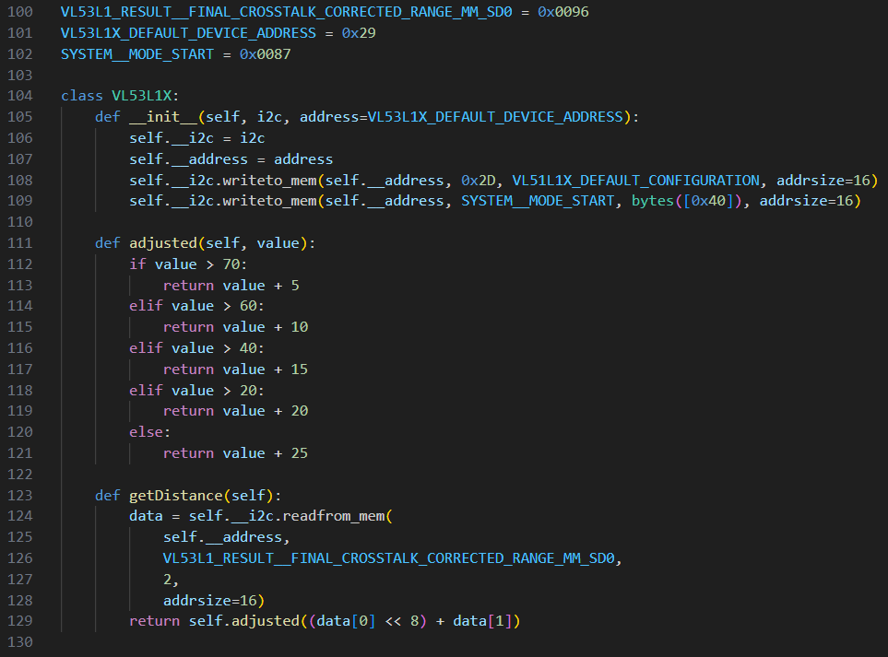
VL53L1X Driver
Based on STM drivers
Minimum functionality
Causes blocking issues

Slide 9
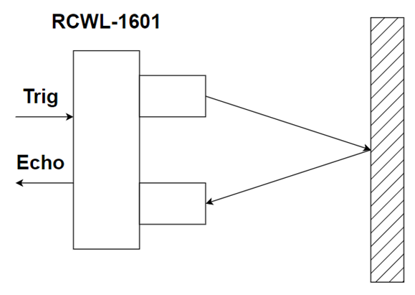
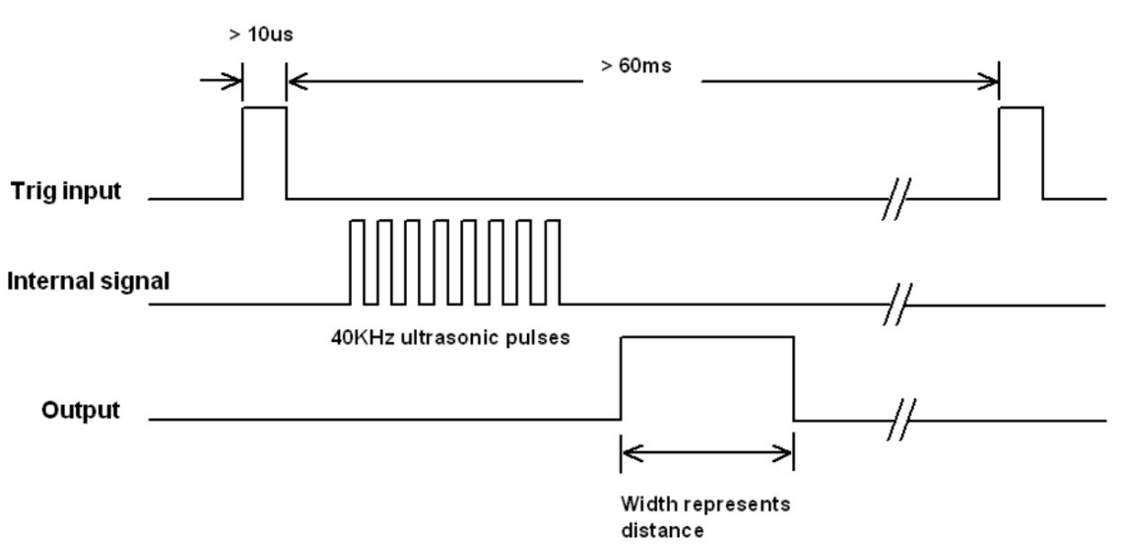
HC-SR04
Notes:
For the ultrasonic pulses to begin, the trigger pin needs to be set HIGH for $10μs$ and then left LOW for 60ms to avoid any interference. The echo pin is then used to measure the pulse time. Once the signal is sent, the echo pin goes HIGH, and when the signal is received, it drops to LOW.

Slide 10
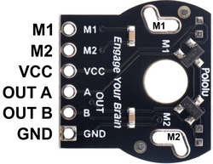
Romi Encoder Pair Kit
Dual-channel Hall effect sensor and a 6-pole magnetic disc
Quadrature encoding
https://www.pololu.com/product/3542

